Slide 1
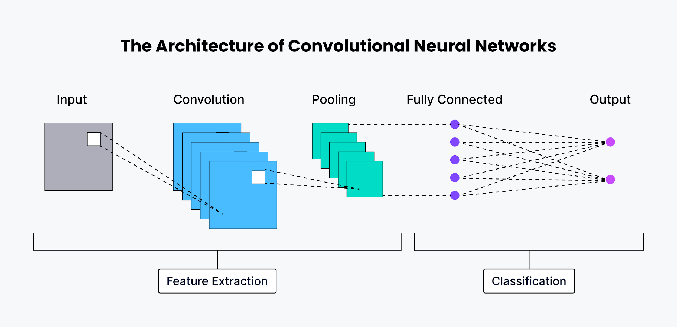
Binary Classification of Dermoscopic Lesions via Bayesian-Optimized Ensemble Convolution Neural Networks
03.19.2025
Michael Li
University of Notre Dame
Mentored by: Dr. Jianneng Li

Slide 2
Artificial Intelligence Powered Detection of Skin Cancer
03.19.2025
Michael Li
University of Notre Dame
Mentored by: Dr. Jianneng Li

Slide 3
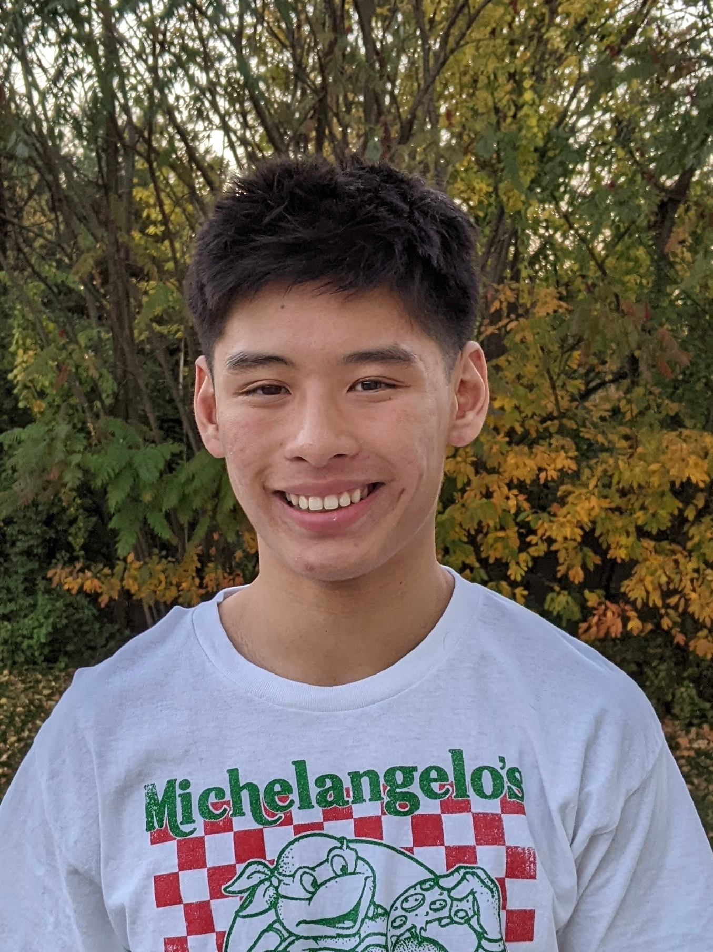
Introduction
03.19.2025
My name is Michael Li.
Class of 2026
Neuroscience Major (B.S)
Montreal, Quebec —----> Allentown, Pennsylvania

Slide 4
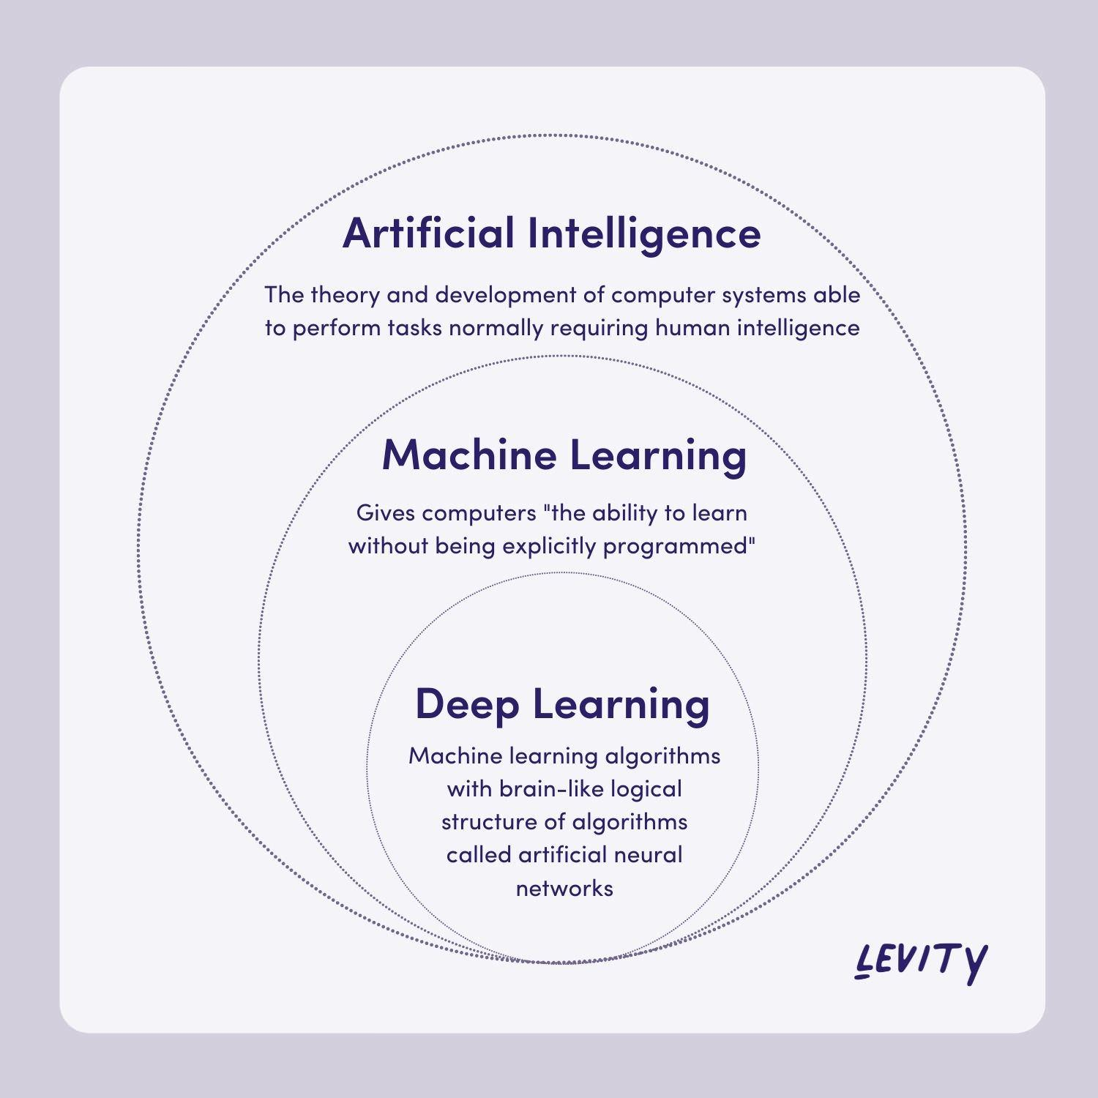
Science Presentation
1.
What is Deep Learning?
AI: Creating machines that can perform tasks that require human intelligence
Machine Learning: Focused on algorithms, learn patterns from data
Deep Learning: subset of machine learning using neural network with layers
Like a brain!

Slide 5
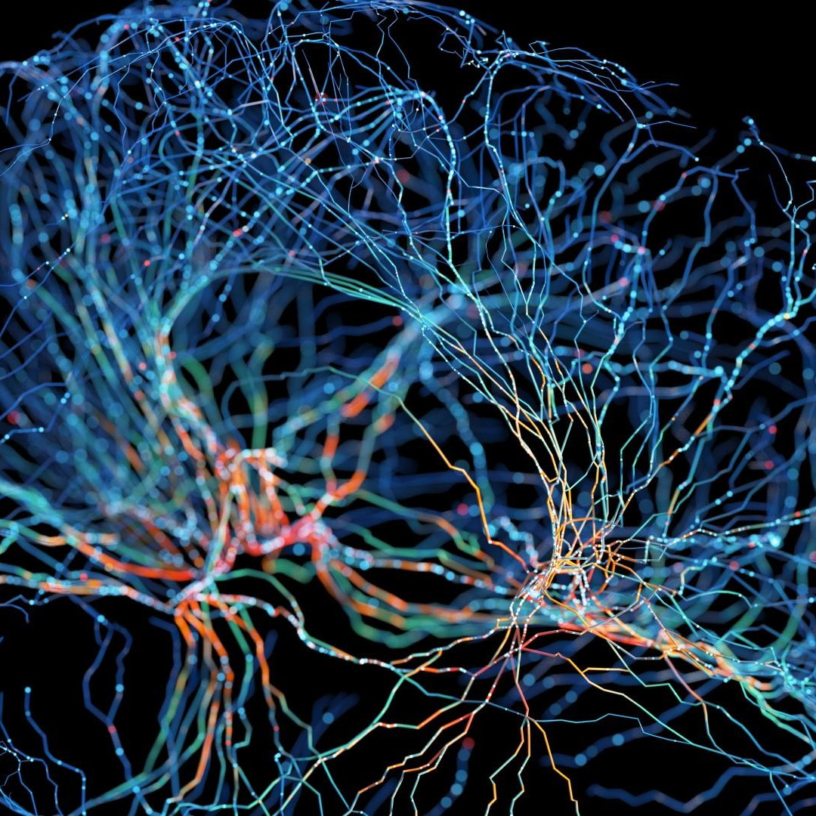
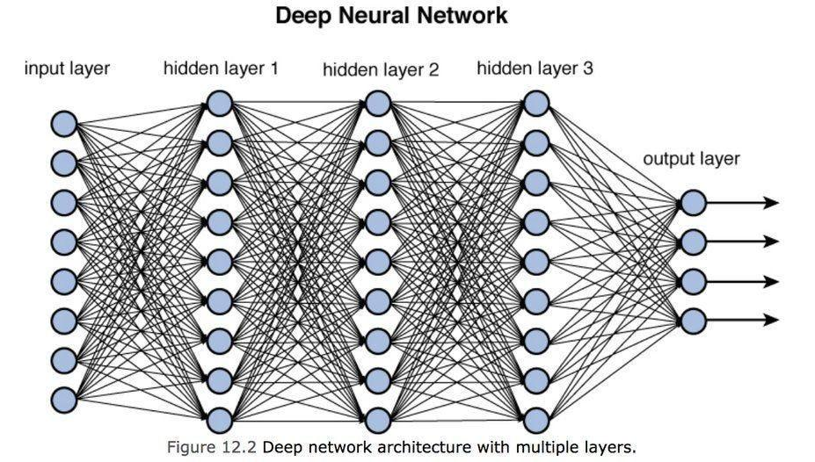
Science Presentation
1.
Deep Learning

Slide 6
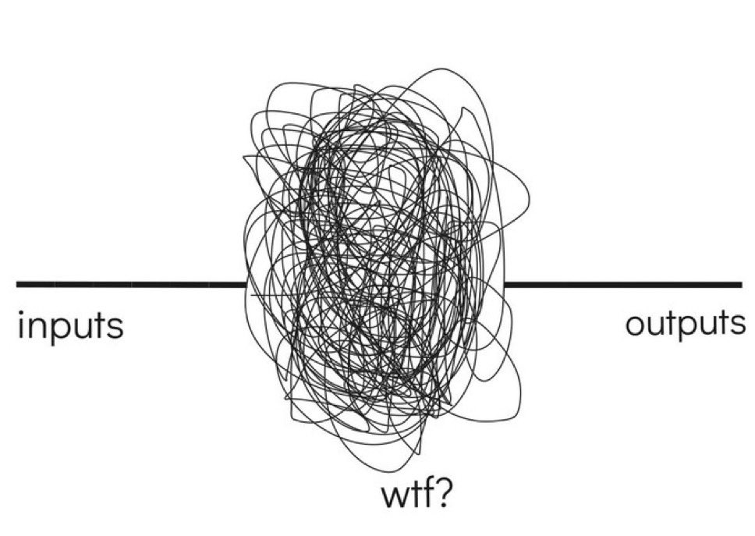
Science Presentation
1.
What is a Neural Network
Does anyone know what is going on?

Slide 7
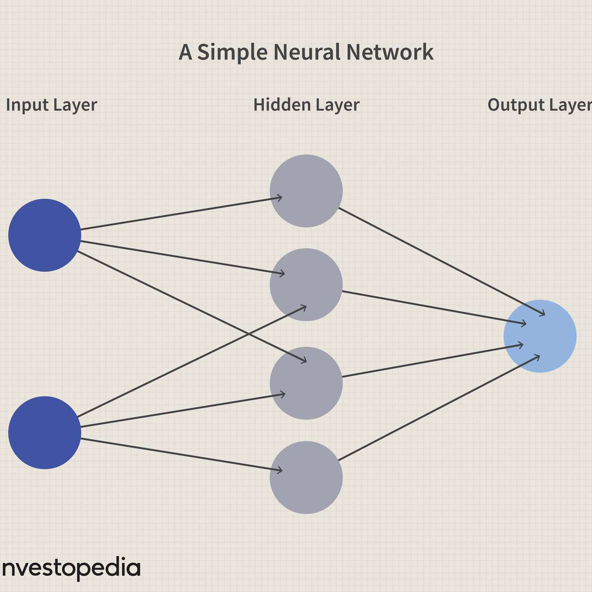
Science Presentation
1.
What is a Neural Network
Input Layer: Receives the initial data: like a pixel value in an image
Hidden Layer: Intermediate layer where processing occurs
Output Layer: Produce a final result/prediction

Slide 8
Science Presentation
1.
How does a Neural Network Work
Each connection has a “weight”, which adjusts as the network learns
1. Receives a signal from previous neurons, multiplied by connection weight
2. Neuron applies an activation function to the sum of the weighted inputs
3. If the result exceeds a threshold, the neuron “fires”, sending is signal to the next layer
4. Backpropagation: Network adjusts its weights based on the error of its prediction

Slide 9
Science Presentation
1.
Neural Network: Gossiping
Group of students (neurons) passing notes in a classroom. Each student has different relationships (weights) with other students that determine how seriously they take each other's messages.
When a rumor (input signal) starts at the front of the class:
Each student receives notes from multiple classmates, but values each note differently based on their relationship strength with each sender
Each student has their own "thinking process" (activation function) to decide what to believe based on all the notes they received
If they're convinced enough, they'll write new notes and pass them to the next row of students
When the rumor reaches the back of the class, the teacher compares it to the truth

Slide 10
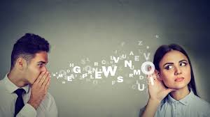
Science Presentation
1.
Neural Network: Gossiping
6. Backpropagation: The teacher walks backward through the classroom, telling each student how wrong the final rumor was. Each student then adjusts how much they trust (weight) messages from different classmates based on who led them astray.
7. Over many rumors, the students learn optimal trust levels for each classmate, so accurate information flows through the classroom while minimizing distortions.

Slide 11
Science Presentation
1.
Types of Neural Networks
Feedforward Networks: Information flows in one direction
Convolutional Neural Networks (CNNs): Specialized for processing grid-like data such as images
Recurrent Neural Networks (RNNs): Have connections that form cycles, allowing them to maintain memory of previous inputs
Transformers: Use attention mechanisms to weigh the importance of different parts of the input data

Slide 12
Science Presentation
1.
What is a CNN
Convolutional Layers
Apply “kernels” across the input (which would be an image)
Each kernel detects patterns (like edges, textures, or shapes)
Earlier layers detect simple features, deeper detects complex
Pooling Layers
Reduces spatial dimensions (L and W) of the data
Helps make the network less sensitive to exact positions of features
Feature Maps
Output of applying filters to the previous layer
Each feature map highlights where specific patterns appear
Fully Connected Layer
Connect every neuron in one layer to every neuron in the next
Process features and perform final classification

Slide 13
Science Presentation
1.
CNN Basic Workflow
An image enters as a grid of pixel values
Convolutional layers apply different filters to detect features (edges, corners, textures)
Pooling layers simplify these feature maps by reducing their size
More convolutional and pooling layers detect increasingly complex patterns
Fully connected layers interpret these high-level features for classification

Slide 14
Science Presentation
1.
Analogy (CNN)
Art Detectives examining a painting for authenticity
Junior Detectives aka, first convolutional layers work with a magnifying glass and look at basic stuff, like straight lines, curves, etc
Shift Supervisors (Pooling Layers): review junior detectives work, create simplified summaries keeping the important findings
Senior Detectives (Deeper Convolutional Layers) combine the simplified reports from supervisors and look for more complex patterns (Brush techniques)
Agency Director (Fully Connected Layer) receives all the processed information and makes final judgement

Slide 15

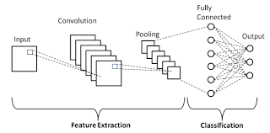

Slide 16
Science Presentation
1.
What are the specific CNN’s I used?
Resnet101
EfficientNet-B7
Densenet121
Why use multiple?
Ensembling combines multiple models to produce better predictions than any single model alone. Different models make different mistakes, and have different strengths/weaknesses so combining their predictions reduces overall error and improves reliability?
Why do dynamic weighting?
One model might be better than the others?

Slide 17
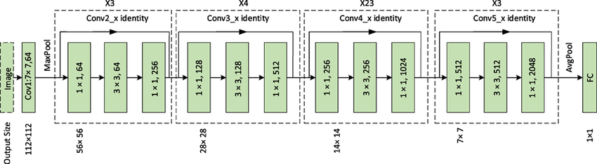
Science Presentation
1.
ResNet101

Slide 18
Science Presentation
1.
Resnet101 Simplified
101 layers
Its special feature is "skip connections" that let information jump ahead, solving the problem where very deep networks struggle to learn effectively.
Think of it like adding express elevators to a very tall building – information can travel directly between distant floors instead of stopping at every level, making the whole system work better.

Slide 19
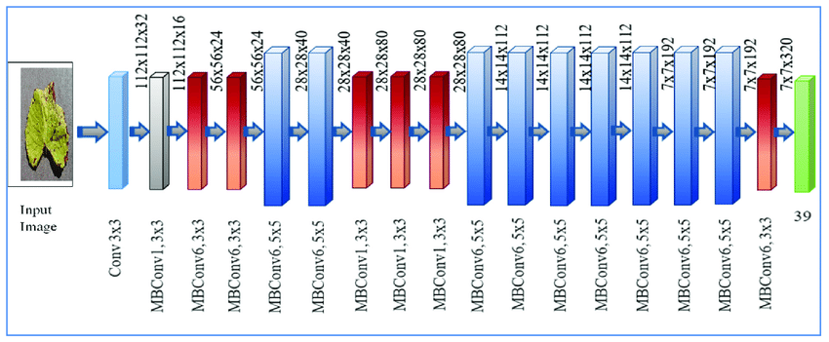
Science Presentation
1.
EfficientNet-B7

Slide 20
Science Presentation
1.
EfficientNet-B7 Simplified
Instead of just adding more layers like older models, it carefully grows in three balanced ways: it gets deeper (more layers), wider (more filters), and looks at higher resolution images.
Think of it like building a house - rather than just making it taller or wider, EfficientNet-B7 grows proportionally in all dimensions for the best results.
It's like getting a premium camera that takes excellent photos while using less battery power than other high-end cameras.

Slide 21
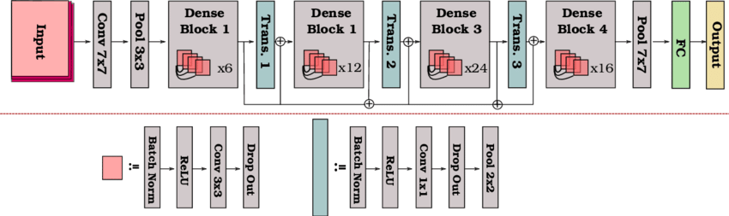
Science Presentation
1.
DenseNet-121

Slide 22
Science Presentation
1.
DenseNet-121 Simplified
121 layers
DenseNet121 is like a classroom where every student can see all the notes from previous classes.
Instead of just building on the last lesson, each layer in the network can access all the information learned in earlier layers. This helps the network reuse features instead of relearning them, making it more efficient with fewer parameters.
Imagine connecting everything to everything ahead of it - that's what makes DenseNet "dense" and helps it make better predictions while requiring less computing power.

Slide 23
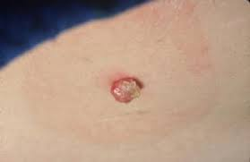
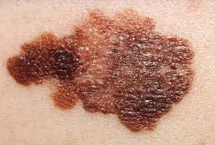
Science Presentation
1.
What did I do?

Slide 24
Science Presentation
1.
Is this important? Maybe
Skin cancer is the most common cancer in the US
2 million Americans a year are diagnosed with it
1 in 5 people in America will develop skin cancer by the age of 70
Statistics suggest that this is on the rise
Early detection is IMPORTANT!
When melanoma is detected early, its 5-year survival rate is approximately 99%.
This rate drops dramatically to 74% if the malignancy to nearby lymph nodes and to a reported 35% if it is allowed metastasizes to distant organs.

Slide 25
Science Presentation
1.
Is this needed? Maybe
Sensitivity and Specificity using clinical examination and images of melanoma were 76.9% and 89.1% for experienced dermatologists
Compared with 78.3% and 66.2% for inexperienced dermatologists
37.5% and 84.6% for primary care physicians (PCPs)
Using in-person dermoscopy and dermoscopic images, they were 85.7% and 81.3% for experienced dermatologists, 78.0% and 69.5% for inexperienced dermatologists, and 49.5% and an impressive 91.3% for PCPs.

Slide 26
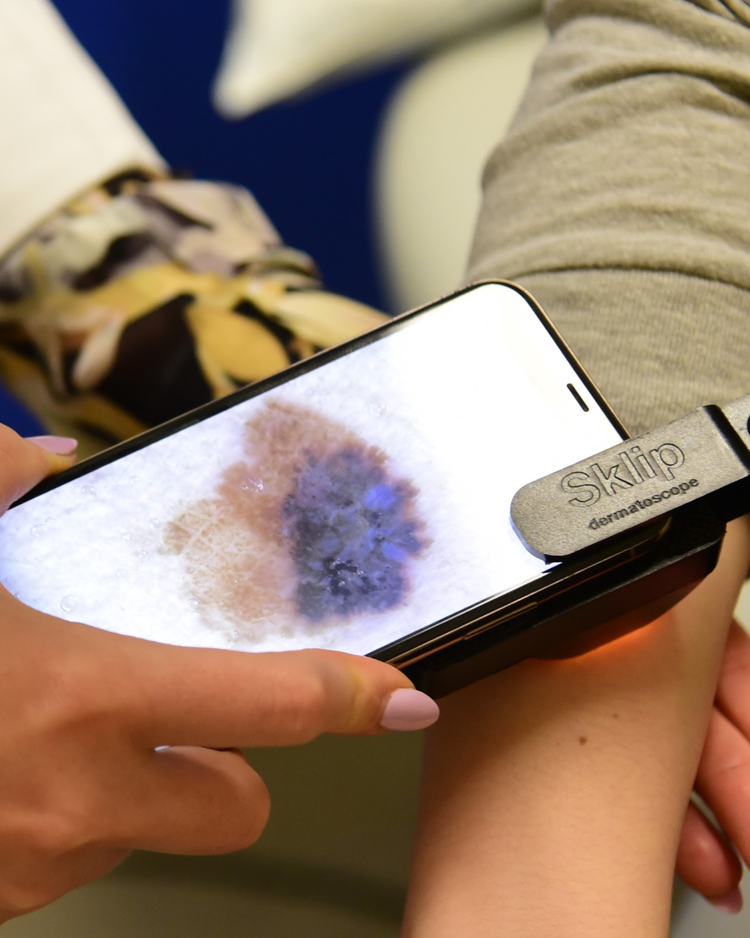
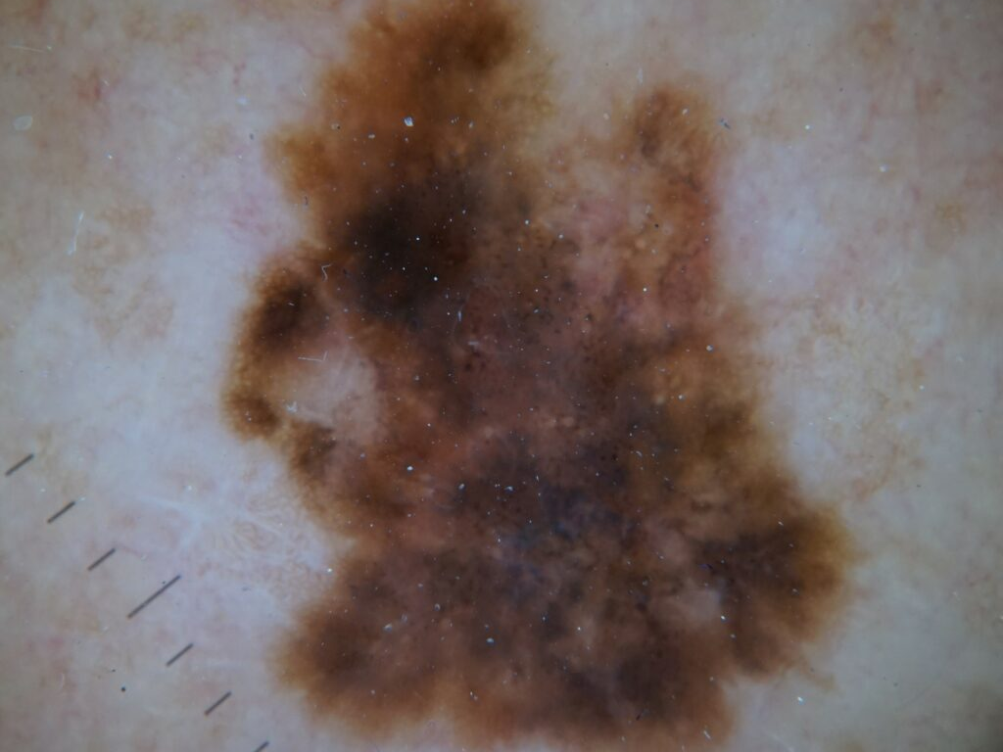

Slide 27
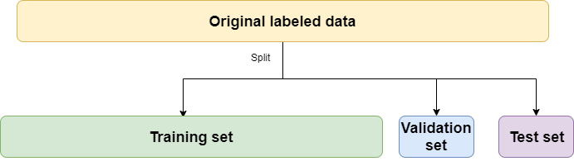
Science Presentation
1.
How exactly do you do this?

Slide 28
Science Presentation
1.
What is a validation dataset?
The validation set helps determine how well a model generalizes to new, unseen data, and it's used to make adjustments to the model's parameters or architecture.
Just how you can tell your brain to focus on certain things or avoid certain things, you can do the same with CNN with “hyperparameter tuning”
More on this to follow

Slide 29
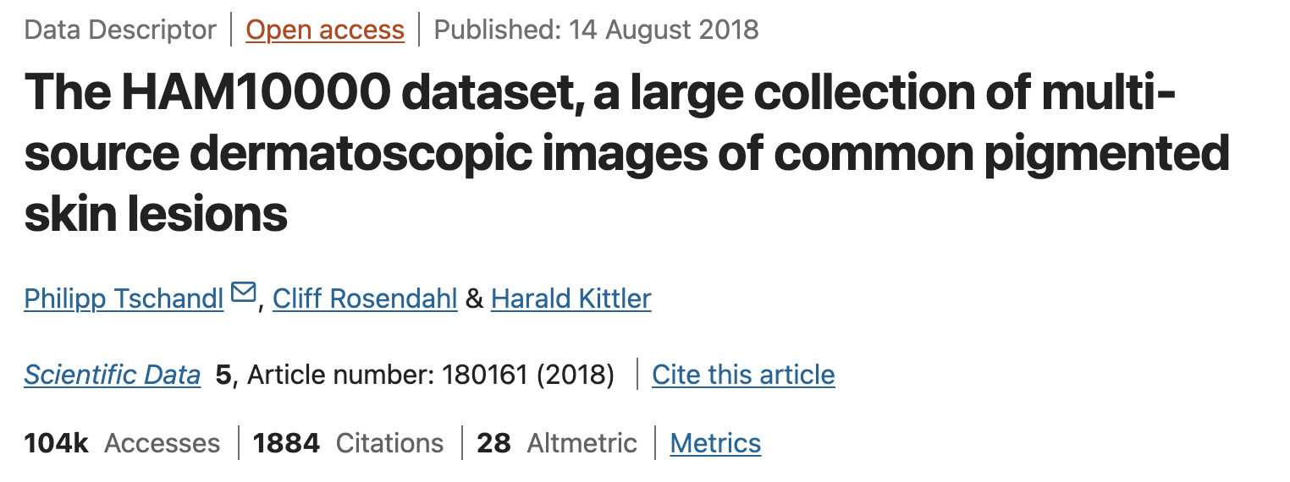
Science Presentation
1.
Where did I get my data?

Slide 30
Science Presentation
1.
Did I do Train/Validate/Test?
No
High variance in performance estimates: Results depend heavily on the specific data points that end up in each set
Inefficient use of data: Only a portion of data is used for training
Selection bias: A single random split may not be representative of the overall data distribution

Slide 31
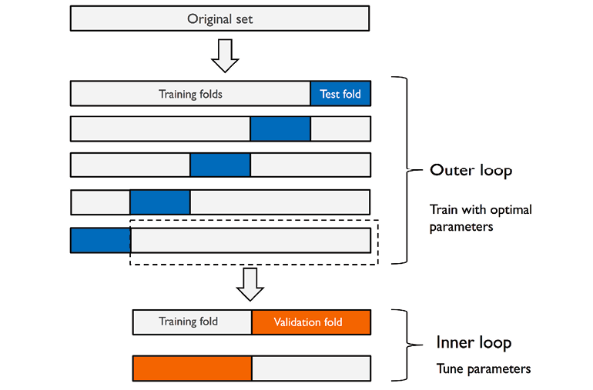
Science Presentation
1.
Nested Cross-Validation
Uses two nested loops of cross-validation
Outer loop: Estimates generalization performance
Inner loop: Performs hyperparameter optimization

Slide 32
Science Presentation
1.
Train/Test vs Cross Validation vs Nested Cross Validation
Simple Train/Test Split
This is like having one practice game before the championship. You select players and develop a training program based on their performance in practice, then take them straight to the championship game. You might get lucky, but it's a risky approach!

Slide 33
Science Presentation
1.
Train/Test vs Cross Validation vs Nested Cross Validation
Standard Cross-Validation
This is like having a series of practice games. You try different combinations of players across multiple games, getting a more reliable sense of who performs well consistently. But you're using the same training program for everyone.

Slide 34
Science Presentation
1.
Train/Test vs Cross Validation vs Nested Cross Validation
Nested Cross-Validation
This is like running a complete tournament system:
Outer Loop (Tournament Structure):
Imagine splitting your candidate players into 5 groups (outer fold). You'll run 5 separate mini-tournaments (inner fold), and each time one group sits out as the "final judges."
Inner Loop (Training Program Selection):
Within each mini-tournament, you try different training programs (hyperparameters). For each program, you conduct several practice games, rotating which players participate. You select the training program that performs best overall in that mini-tournament (inner fold).

Slide 35
Science Presentation
1.
Train/Test vs Cross Validation vs Nested Cross Validation
Final Evaluation:
After each mini-tournament selects its best training program, you test it against the group that sat out (who the program has never seen before).
You do this five times, getting five independent measurements (outer fold) of how well your player selection and training program development process works.
The advantage of nested cross-validation is that it tests not just your final team, but your entire team-building process.
It helps you understand how reliable your player selection and training program development methodology is, rather than just evaluating a single team that might have gotten lucky in one practice game.

Slide 36
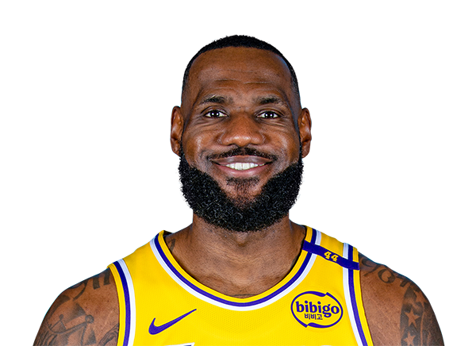

Slide 37
Science Presentation
1.
What are hyperparameters?
Hyperparameters are settings that determine how a machine learning algorithm learns, such as the number of layers in a neural network, the learning rate, or the regularization strength.
Purpose:
They influence the model's architecture, learning speed, and overall performance.
Set before training: They cannot be learned from the data
Control the learning process: They influence how the model learns rather than what it learns
Require tuning: Finding optimal values often involves experimentation

Slide 38
Science Presentation
1.
What are hyperparameters?
Learning Rate: The step size taken when moving toward a solution. Too large causes overshooting; too small leads to slow learning. Like adjusting the speed of a car navigating to a destination.
Number of Iterations/Epochs: How many times the algorithm processes the entire dataset. Too few means incomplete learning; too many can lead to memorization instead of generalization. Similar to deciding how many times to review material before an exam.
Regularization Parameters: Controls that prevent models from becoming unnecessarily complex. Stronger regularization produces simpler models that generalize better but might miss subtle patterns. Like teaching someone to focus on core principles rather than memorizing exceptions.

Slide 39
Science Presentation
1.
How do you tune hyperparameters?
Manual tuning: Based on intuition, experience, and trial-and-error
Grid search: Exhaustively trying all combinations from a predefined set
Random search: Sampling random combinations, often more efficient than grid search
Bayesian optimization: Using past evaluations to guide the search process

Slide 40
Science Presentation
1.
Bayesian Optimization:
Surrogate Model: Typically uses Gaussian Processes to model the relationship between hyperparameters and model performance
Acquisition Function: Determines which points to sample next by balancing:
Exploitation: Sampling where the model predicts high performance
Exploration: Sampling uncertain regions to improve the surrogate model
Sequential Process: After each evaluation, the surrogate model is updated with the new information

Slide 41
Science Presentation
1.
Truffle Hunting: Bayesian Analogy
I am looking for truffles in a really really big forest
Luckily, I have a truffle sniffing dog with me
Initial Exploration: Your dog sniffs at a few random spots in the forest.
Building a Mental Map: After each dig, your dog builds a more refined understanding of where truffles are likely to be found. It notices patterns like "truffles seem to grow near oak trees on north-facing slopes."
Smart Selection: Instead of checking everywhere, your dog considers both:
Places that strongly match the pattern of previous finds (exploitation)
Unexplored areas that might reveal new patterns (exploration)

Slide 42

Science Presentation
1.
Truffle Hunting: Bayesian Analogy
5. Continuous Learning: With each new truffle you find (or don't find), your dog updates its mental map and makes increasingly better predictions about where to look next.
6. Diminishing Returns: As you find more truffles, your dog's understanding becomes more precise, and you spend less time digging in unpromising locations.

Slide 43
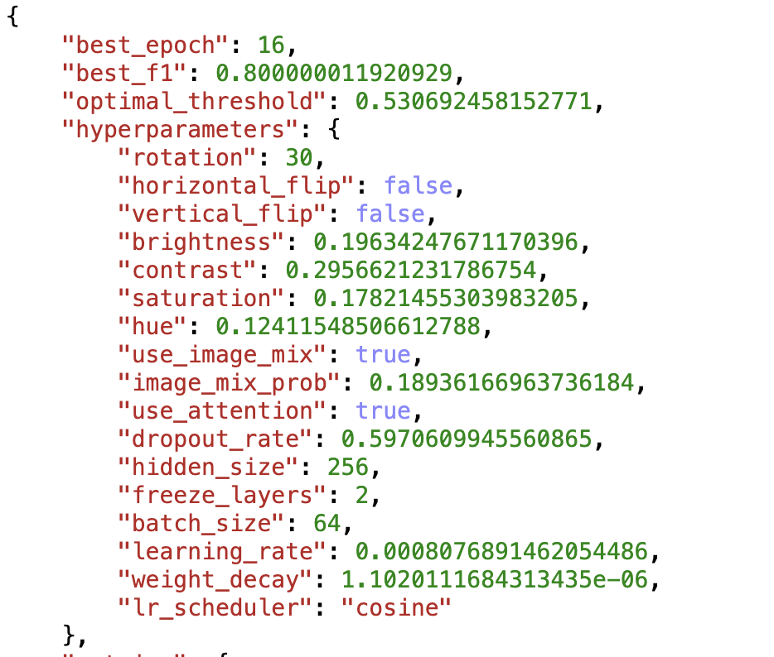
Science Presentation
1.
What hyperparameters did I tune?

Slide 44
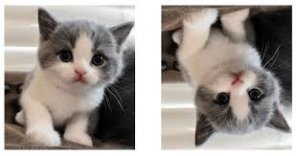
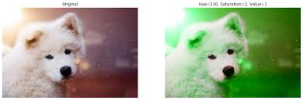
Science Presentation
1.
Examples of Data Augmentation

Slide 45
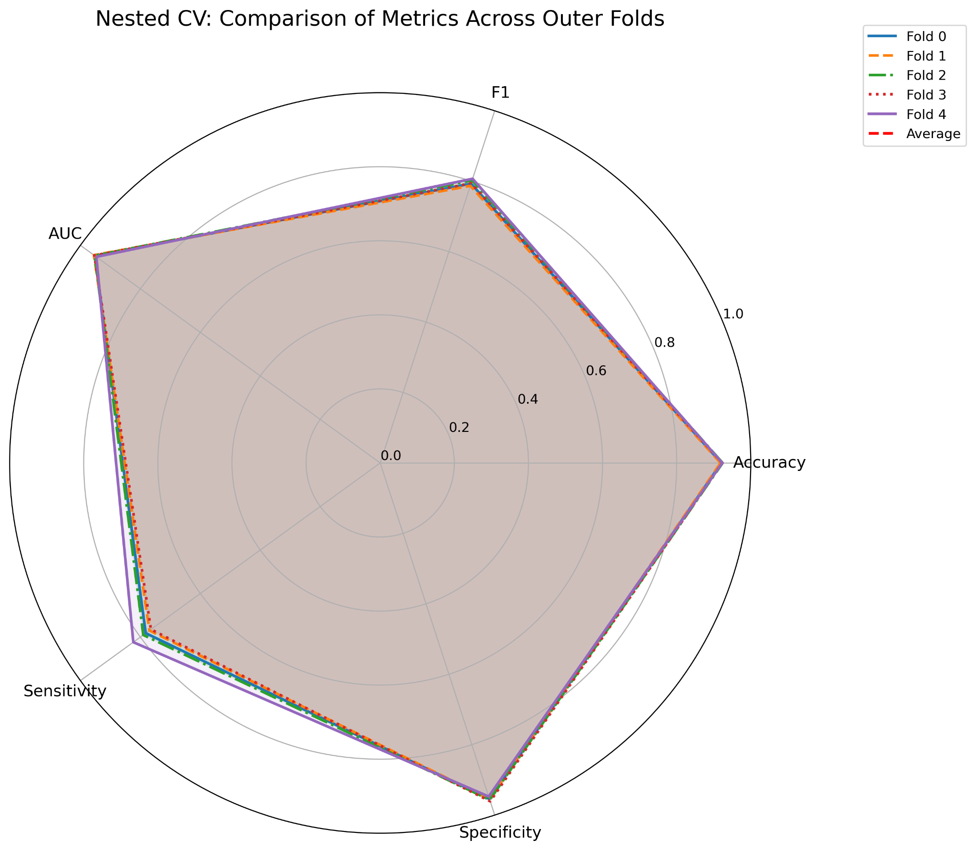
Science Presentation
1.
Results?

Slide 46
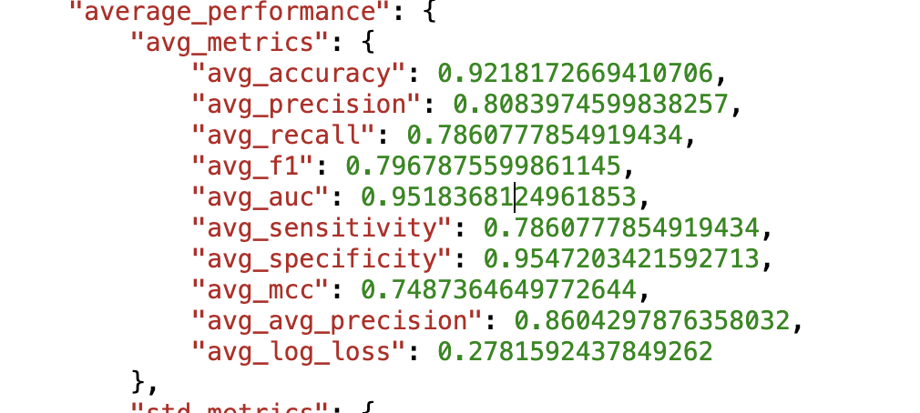
Science Presentation
1.
Results?

Slide 47
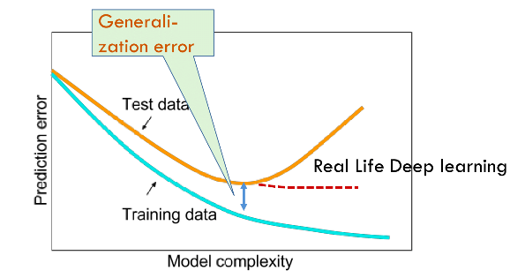

Science Presentation
1.
The issue with AI

Slide 48
Science Presentation
1.
An external test set
External test sets reveal whether a model has truly learned to recognize patterns or just memorized quirks in the training data.
By testing on completely new images collected differently than the training set, we can discover if the model will actually work in real-world situations or if it's just good at one specific dataset.

Slide 49
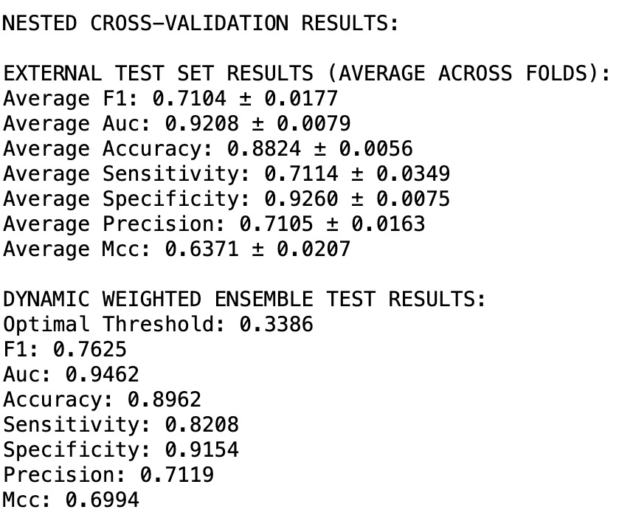
Science Presentation
1.
Results?

Slide 50
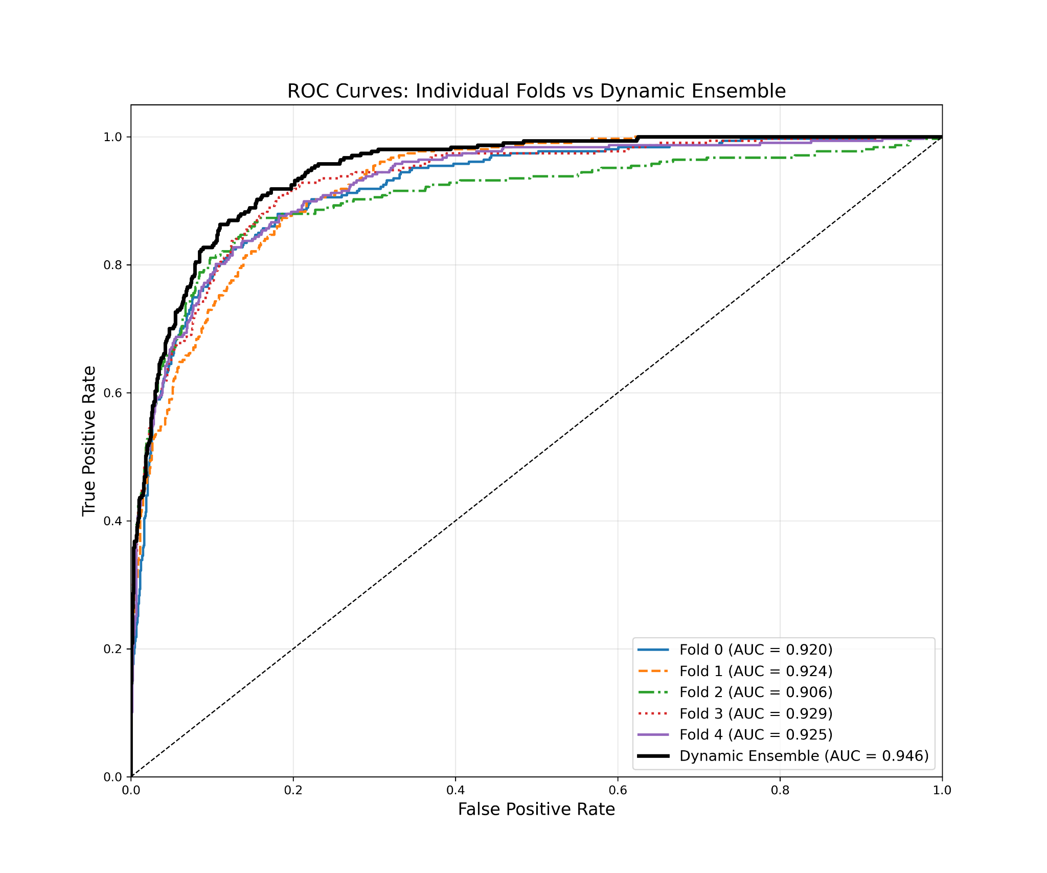

Slide 51
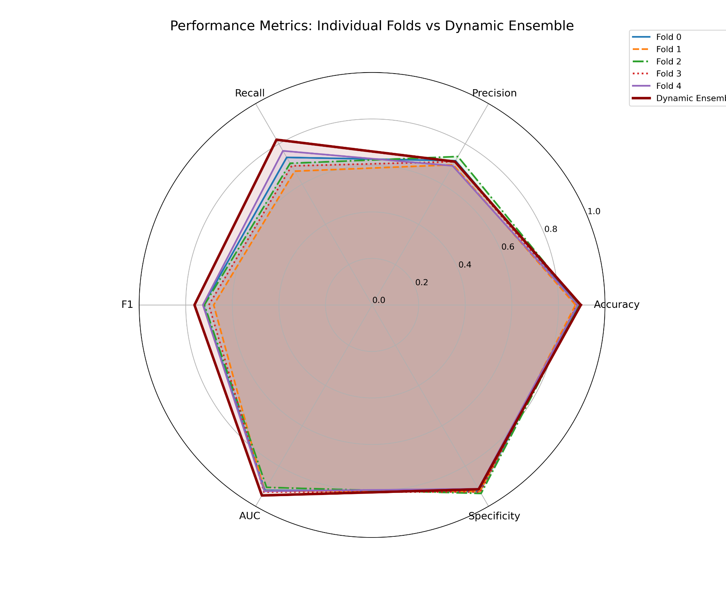

Slide 52
Binary Classification of Dermoscopic Lesions via Bayesian-Optimized Ensemble Convolution Neural Networks

Slide 53


